Slide 1
Phase Transformations
ISSUES TO ADDRESS...
• Transforming one phase into another takes time.
Fe
γ
Fe₃C
Eutectoid
transformation
(cementite)
(Austenite)
+
α
C
FCC
(ferrite)
(BCC)
• How does the rate of transformation depend on
time and T ?
• How can we slow down the transformation so that
we can engineer non-equilibrium structures?
• Are the mechanical properties of non-equilibrium
structures better?

Slide 2
Phase Transformations
Nucleation
  nuclei (seeds) act as template to grow crystals
  for nucleus to form rate of addition of atoms to nucleus must be faster than rate of loss
  once nucleated, grow until reach equilibrium
Driving force to nucleate increases as we increase ΔT
  supercooling (eutectic, eutectoid)
  superheating (peritectic)
Small supercooling → few nuclei - large crystals
Large supercooling → rapid nucleation - many nuclei,
small crystals
Notes:
In Chapter 9 we looked at the equilibrium phase diagram . This indicated phase structure if we wait long enough. But due to slow diffusion may not reach equilibrium We need to consider time- kinetics - energy of phase boundaries may be high. – also nucleation
Transformation rate
How fast do the phase transformations occur?
First need nuclei (seeds) to form for the rest of the material to crystallize

Slide 3
Solidification: Nucleation Processes
Homogeneous nucleation
  nuclei form in the bulk of liquid metal
  requires supercooling (typically 80-300°C max)
Heterogeneous nucleation
  much easier since stable “nucleus” is already present
    Could be wall of mold or impurities in the liquid phase
  allows solidification with only 0.1-10ºC supercooling
  often added on purpose… like in “snow making”

Slide 4
Rate of Phase Transformations
Kinetics - measure approach to equilibrium vs. time
Hold temperature constant & measure conversion vs. time
How is conversion measured?
X-ray diffraction
electrical conductivity
sound waves
optical microscopy, lasers

Slide 5
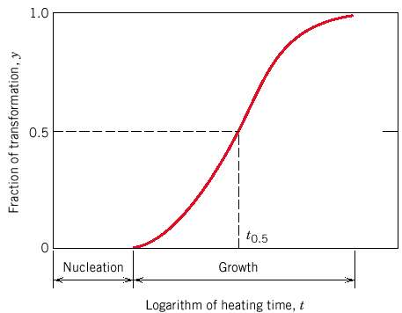
Rate of Phase Transformation
All out of material - done
Fixed T
Fraction transformed, y
0.5
maximum rate reached – now amount
unconverted decreases so rate slows
rate increases as surface area increases
& nuclei grow
t_{0.5}
log t
Avrami rate equation => y = 1- exp (-kt^{n})
  k & n fit for specific sample
fraction transformed
time
By convention r = 1 / t_{0.5}
Notes:
S.A. = surface area

Slide 6
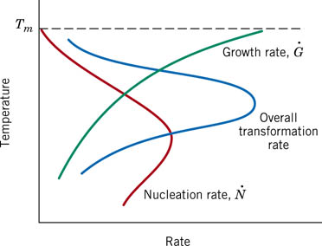
Rate of Phase Transformations

Slide 7
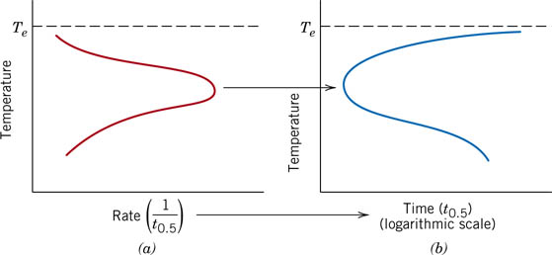
Rate of Phase Transformations

Slide 8
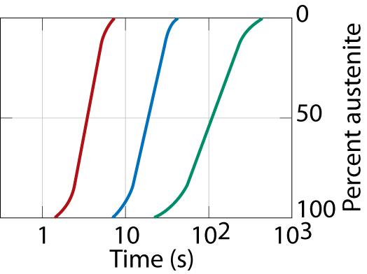
Eutectoid Transformation Rate
• Growth of pearlite from austenite:
Diffusive flow
Austenite (γ)
of C needed
cementite (Fe₃C)
grain
α
Ferrite (α)
α
boundary
α
γ
γ
α
γ
γ
Adapted from Fig. 9.15, Callister 7e.
α
pearlite
α
α
growth
α
direction
α
• Recrystallization
rate increases
with ΔT.
100
600°C
(ΔT larger)
50
650°C
Adapted from Fig. 10.12, Callister 7e.
y (% pearlite)
675°C
(ΔT smaller)
0
Coarse pearlite → formed at higher T - softer
Fine pearlite → formed at low T - harder

Slide 9

Nucleation and Growth
• Reaction rate is a result of nucleation and growth
of crystals.
100
Nucleation rate increases with ΔT
% Pearlite
Growth
regime
Growth rate increases with T
50
Nucleation
regime
0
t
0.5
log (time)
• Examples:
pearlite
γ
colony
γ
γ
T just below
T_{E}
T moderately below
T_{E}
T way below
T_{E}
Nucleation rate low
Nucleation rate med
.
Nucleation rate high
Growth rate high
Growth rate med.
Growth rate low

Slide 10
Transformations & Undercooling
•
Eutectoid
transf. (Fe-C System):
γ
⇒
α
+
Fe₃C
0.76 wt% C
6.7 wt% C
0.022 wt% C
T(°C)
1600
δ
1400
L
γ
γ
+L
1200
(austenite)
1148°C
L+Fe₃C
α
1000
γ
+Fe₃C
Eutectoid:
Fe₃C (cementite)
ferrite
800
Equil. Cooling: T_{transf.} = 727ºC
ΔT
727°C
α
+Fe₃C
600
Undercooling by ΔT_{transf.} < 727°C
400
0.022
0.76
0
1
2
3
4
5
6
6.7
(Fe)
C_{o} , wt%C

Slide 11
Isothermal Transformation (T-T-T) Diagrams
• Fe-C system, C_{o} = 0.76 wt% C
• Transformation at T = 675°C.
100
T = 675°C
y,
% transformed
50
0
2
4
1
10
10
time (s)
T(°C)
Austenite (stable)
T_{E} (727°C)
700
Austenite
(unstable)
600
Pearlite
isothermal transformation at 675°C
500
50%
100%
0%pearlite
400
time (s)
1
10
10
2
10
3
10
4
10
5

Slide 12
Effect of Cooling History in Fe-C System
• Eutectoid composition, C_{o} = 0.76 wt% C
• Begin at T > 727°C
• Rapidly cool to 625°C and hold isothermally.
T(°C)
Austenite (stable)
T_{E} (727°C)
700
Austenite
(unstable)
600
Pearlite
γ
γ
γ
γ
γ
γ
500
50%
100%
0%pearlite
400
1
10
10
2
10
3
10
4
10
5
time (s)

Slide 13
Transformations with
Proeutectoid Materials
C_{O} = 1.13 wt% C
T(°C)
T(°C)
900
1600
δ
A
1400
L
800
T_{E} (727°C)
+
A
γ
γ
+L
1200
(austenite)
L+Fe₃C
700
A
C
P
1000
Fe₃C (cementite)
+
P
α
γ
+Fe₃C
600
A
800
ΔT
727°C
500
600
α
+Fe₃C
1
10
10²
10³
10⁴
0.022
0.76
400
0
1.13
time (s)
1
2
3
4
5
6
6.7
(Fe)
C_{o} , wt%C
Hypereutectoid composition – proeutectoid cementite

Slide 14
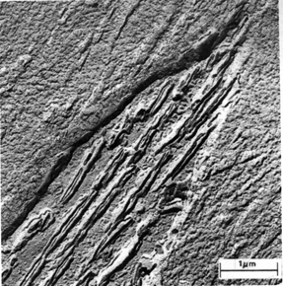
Non-Equilibrium Transformation Products: Fe-C
• Bainite:
--α lathes (strips) with long
rods of Fe₃C
--diffusion controlled.
• Isothermal Transf. Diagram
Fe₃C
(cementite)
α
(ferrite)
800
Austenite (stable)
T(°C)
T_{E}
A
P
600
100% pearlite
5 μm
pearlite/bainite boundary
100% bainite
400
A
B
200
0%
50%
100%
10
-1
10
10
3
10
5
time (s)

Slide 15
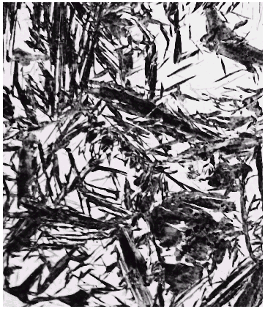

Martensite: Fe-C System
• Martensite:
--γ(FCC) to Martensite (BCT)
(involves single atom jumps)
Fe atom
x
potential
sites
x
x
60 μm
x
x
C atom sites
x
• Isothermal Transf. Diagram
800
Martensite needles
Austenite (stable)
Austenite
T(°C)
T_{E}
A
P
600
400
A
B
• γ to M transformation..
-- is rapid!
-- % transf. depends on T only.
100%
0%
50%
200
M + A
0%
M + A
50%
M + A
90%
10
-1
10
10
3
10
5
time (s)

Slide 16
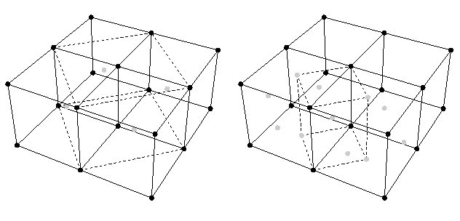
Martensite: FCC → Body-Centered Tetragonal

Slide 17
Martensite Formation
γ (FCC) α (BCC) + Fe₃C
slow cooling
quench
tempering
M (BCT)
M = martensite is body centered tetragonal (BCT)
Diffusionless transformation BCT if C > 0.15 wt%
  BCT → few slip planes → hard, brittle

Slide 18
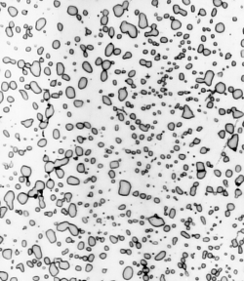
Spheroidite: Fe-C System
α
(ferrite)
• Spheroidite:
--α grains with spherical Fe₃C
--diffusion dependent.
--heat bainite or pearlite for long times
--reduces interfacial area (driving force)
--Temperature is just under eutectoid (~700 C)
--soft and ductile, easily machined
Fe₃C
(cementite)
60 μm

Slide 19
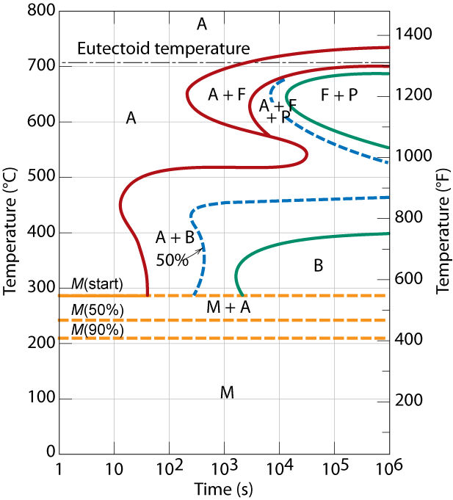
Phase Transformations of Alloys
Effect of adding other elements
  Change transition temp.
Cr, Ni, Mo, Si, Mn
retard γ → α + Fe₃C
transformation

Slide 20
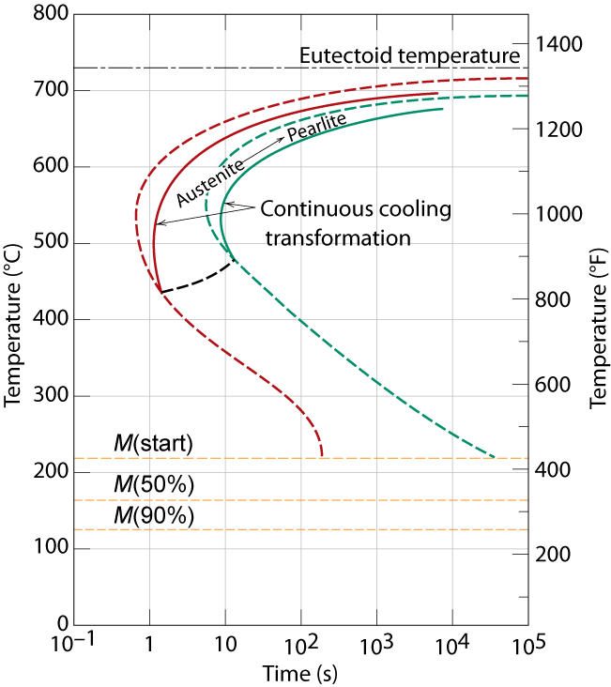
Cooling Curve
plot temp vs. time
Notes:
Actual processes involves cooling – not isothermal
Can’t cool at infinite speed

Slide 21
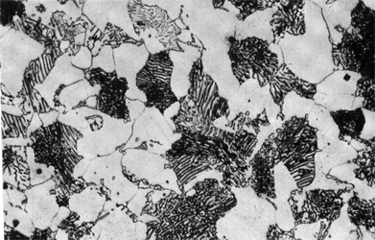
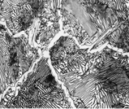
Mechanical Prop: Fe-C System (1)
• Effect of wt% C
Pearlite (med)
Pearlite (med)
C
ementite
ferrite (soft)
(hard)
C_{o} < 0.76 wt% C
C_{o} > 0.76 wt% C
Hypoeutectoid
Hypereutectoid
Hypo
Hyper
Hypo
Hyper
TS(MPa)
1100
%EL
80
YS(MPa)
100
900
hardness
40
700
Impact energy (Izod, ft-lb)
50
500
0
300
0
0.5
1
0
0.76
wt% C
0
0.5
0.76
1
wt% C
• More wt% C: TS and YS increase
, %EL decreases.

Slide 22
Mechanical Prop: Fe-C System (2)
• Fine vs coarse pearlite vs spheroidite
Hypo
Hyper
90
Hypo
Hyper
320
fine
spheroidite
pearlite
60
240
coarse
pearlite
Ductility (%AR)
Brinell hardness
spheroidite
160
30
coarse
pearlite
fine
80
pearlite
1
0
0
0.5
wt%C
0
0.5
1
wt%C
• Hardness:
fine > coarse > spheroidite
• %RA:
fine < coarse < spheroidite

Slide 23
Mechanical Prop: Fe-C System (3)
• Fine Pearlite vs Martensite:
Hypo
Hyper
600
martensite
Brinell hardness
400
200
fine pearlite
0
0
0.5
wt% C
1
• Hardness: fine pearlite << martensite.

Slide 24
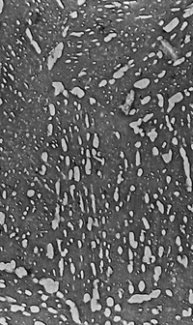
Tempering Martensite
• reduces brittleness of martensite,
• reduces internal stress caused by quenching.
TS(MPa)
YS(MPa)
1800
1600
TS
1400
YS
9 μm
1200
60
1000
50
%RA
%RA
40
800
30
200
400
600
Tempering T (°C)
•
produces extremely small Fe₃C particles surrounded by α.
•
decreases TS, YS but increases %RA

Slide 25
Summary: Processing Options
Austenite (γ)
slow
moderate
rapid
cool
cool
quench
Pearlite
Bainite
Martensite
(α + Fe₃C layers + a
(α + Fe₃C plates/needles)
(BCT phase
proeutectoid phase)
diffusionless
transformation)
martensite
reheat
temp. martensite
bainite
Tempered
Strength
fine pearlite
Ductility
Martensite
coarse pearlite
(α + very fine
spheroidite
Fe₃C particles)
General Trends

Slide 26
Dynamic Phase Transformations
On the isothermal transformation diagram for 0.45 wt% C Fe-C alloy, sketch and label the time-temperature paths to produce the following microstructures:
  42% proeutectoid ferrite and 58% coarse pearlite
  50% fine pearlite and 50% bainite
  100% martensite
  50% martensite and 50% austenite

Slide 27
Example Problem for C_{o} = 0.45 wt%
42% proeutectoid ferrite and 58% coarse pearlite
first make ferrite
then pearlite
Coarse pearlite
∴ higher T
800
A + α
A
T (°C)
A + P
600
P
B
A + B
A
400
50%
M (start)
M (50%)
M (90%)
200
Adapted from Fig. 10.29,
Callister 5e.
0
0.1
10
10³
10⁵
time (s)

Slide 28
Example Problem for C_{o} = 0.45 wt%
50% fine pearlite and 50% bainite
first make pearlite
then bainite
fine pearlite
∴ lower T
800
A + α
A
T (°C)
A + P
600
P
B
A + B
A
400
50%
M (start)
M (50%)
M (90%)
200
Adapted from Fig. 10.29,
Callister 5e.
0
0.1
10
10³
10⁵
time (s)

Slide 29
Example Problem for C_{o} = 0.45 wt%
100 % martensite – quench = rapid cool
50 % martensite
and 50 % austenite
800
A + α
A
T (°C)
A + P
600
P
B
A + B
A
400
50%
M (start)
M (50%)
d)
M (90%)
200
Adapted from Fig. 10.29,
Callister 5e.
c)
0
0.1
10
10³
10⁵
time (s)

Slide 30
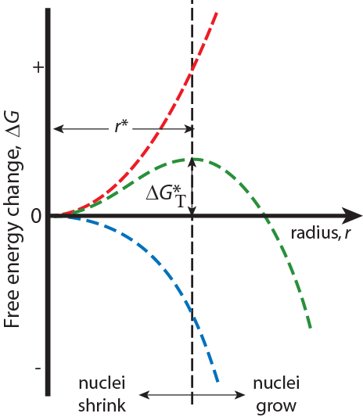
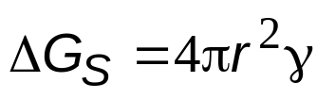
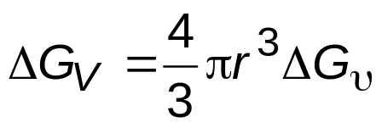
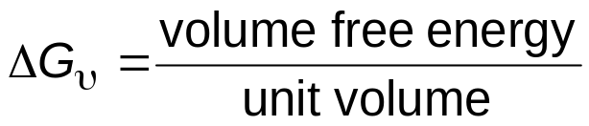
Homogeneous Nucleation & Energy Effects
Surface Free Energy- destabilizes
the nuclei (it takes energy to make
an interface)
γ = surface tension
ΔG_{T} = Total Free Energy
= ΔG_{S} + ΔG_{V}
Volume (Bulk) Free Energy –
stabilizes the nuclei (releases energy)
r* = critical nucleus: nuclei < r* shrink; nuclei>r* grow (to reduce energy)
Adapted from Fig.10.2(b), Callister 7e.

Slide 31
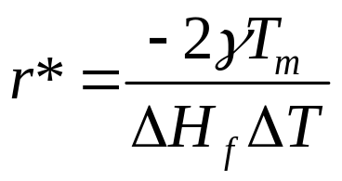
Solidification
r* = critical radius
γ = surface free energy
T_{m} = melting temperature
ΔH_{f} = latent heat of solidification
ΔT = T_{m} - T = supercooling
∴ r* decreases as ΔT increases
Bigger structures nearer Tm, but take longer to form

